Slide 2
About this workbook
This workbook comes from the online inroads workshop Stigma at the Intersections: Abortion, Disability, HIV, and Access. Created for inroads members by: Phylis, Lilian, Medea, Gvantsa, Esma, Naomi, and Jakki.
Based on the slide deck of the 3 sessions, we prepared a workbook version to facilitate the learning experience of all inroads members, including those that were not able to attend the live session.
We invite you to use this material within your community and organization to learn, reflect and brainstorm around the BIG questions that come up in this work, to build understanding and anti-stigma practices inclusive of people with disabilities and other vulnerable groups.

Slide 3
Why disability Inclusion?
1st Session
15-20% of the world’s population experience some form of disability….
80% of persons with disabilities live in the Global South.
30 percent of street youths have some kind of disability.
Ninety per cent of children with disabilities in developing countries do not attend school.
Disability disproportionately impacts marginalized populations like the poor, homeless persons and refugees.
Women with disabilities are recognized to be multiply disadvantaged, experiencing exclusion on account of their gender and their disability.
only 45 countries have anti-discrimination and other disability-specific laws!
In countries with life expectancies over 70 years, individuals spend on average about 8 years, or 11.5 per cent of their life span, living with disabilities.

Slide 4
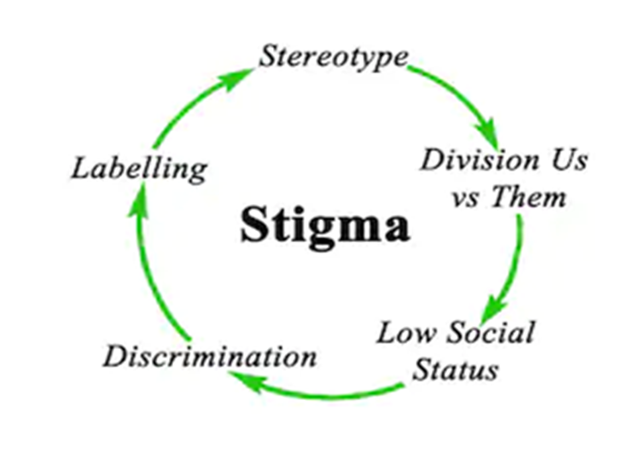
Stigma
Disability is often stigmatized through this process of Othering. The attribution of negativity and undesirability of the ‘other’ calls for devaluation and negation.
The stigma – the devaluation and negation – of disability is extended to families and associates of the ‘Other’. This is called stigma by association.
Inclusion and belonging are key attributes of communal and social life. Hence stigma often leads to the hiding and exclusion of persons with disabilities within families and communities.
Stigma is underscored by shame and the fear of exclusion.
Notes:
Enforcing the norm gives rise to compulsory heteronormativity and compulsory abledness It provides entitlements for those who conform and exclude those who do not – Tyranny of the Norm

Slide 5
How does stigma at different levels look like for Disabled People?
Patriarchy
Society's attitude to disability
Access to appropriate services
Disabled women and trans-men

Slide 6
Ableism as a contributing factor to abortion stigma
Ableism may be conscious or unconscious, and may be embedded in institutions, systems or the broader culture of a society.
Ableism can limit persons with disabilities from access information and services on abortion.
People with disabilities may also be perceived to lack the capacity.
Notes:
Ableism- dricrimination in favour of able bodied
NB if you have disability you are considered unfit, not eligible or do not qualify
To make decision in their own best interest. This may not be the case but it is always assumed.

Slide 7
Consider the lived realities while accessing abortions services.
Even in matters of abortion, people with disabilities can make their own decisions.
Accessibility- sign language interpretation, disability etiquette, Braille materials and signage.
Stigma and discrimination.
Economic barriers- affordability
Low literacy levels
Patriarchy- Power, control and decision making.

Slide 8
Additional considerations about Abortion and Disability
Due to stigma, people with disabilities often do not receive information about or access to safe abortion or contraceptive care. As a result, they experience an increased risk of unwanted pregnancy and unsafe abortion—and the associated risk of injury or death.
Women and girls face judgment and discrimination for many things related to sexuality and reproduction, including unwanted pregnancy and abortion. Young women and adolescent girls often are not considered mature enough to make decisions about having sex or an abortion.
Notes:
5:55 pm Kenya

Slide 9
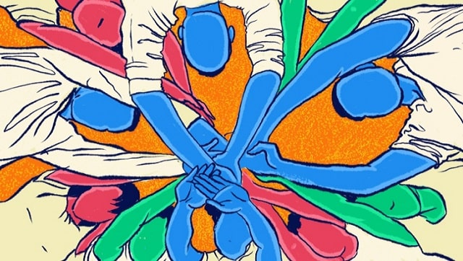
Understanding and unlearning ableism is an ongoing process and one we must work on day-to-day
It’s a collective responsibility.
We invite you yo use the following exercise to reflect and identify spaces for inclusion.
Notes:
People must be intentional about it

Slide 10
How is Disability perceived in your context?
Disability is perceived as shameful for the person and /or the family.
Use these “sticker dots” to agree with what someone else has written

Slide 11
Unfit
Controlled
Shamed
Labelled
Responsible
Isolated
Vulnerable
Stigma
Humiliated
Devalued
Judged
Bullied
Silenced
Assumptions
Hidden lives
No trust
Inescapable
Powerless

Slide 12
Who speaks on behalf of disability and abortion in your local context?
Not often enough - people with disabilities themselves.
Use these “sticker dots” to agree with what someone else has written

Slide 13
What hinders disability inclusion in your organizing?
.
Lack of funding. Lack of training on disability inclusion.
Stigma around disabled folks and sexuality
Use these “sticker dots” to agree with what someone else has written

Slide 14
How have you included disability in your organizing?
Including disability advocates on our Board.
Use these “sticker dots” to agree with what someone else has written

Slide 15
How can we amplify the voices of people with disabilities who have abortions in your context?
Positive media representation
Use these “sticker dots” to agree with what someone else has written

Slide 16
What are some of the possible solutions that you would recommend to make organizing more disability inclusive?
Creating SRHR sign language glossary.
Use these “sticker dots” to agree with what someone else has written

Slide 17
2nd Session
Towards Intersectionality
Oppression
Intersectionality holds that the classical conceptualizations of oppression within society, such as racism, sexism, homophobia, and religion-based bigotry, do not act independently of one another; instead, these forms of oppression interrelate, creating a system of oppression that reflects the "intersection" of multiple forms of discrimination.’
Response
Intersectionality and the recognition and confrontation of our privilege, can make us better people with better lives.” “Diversity is what happens when you have representation of various groups in one place. Representation is what happens when groups that haven’t previously been included, are included.

Slide 18
Laying it bare……….
What is the current discourse?
What are the issues for women, pregnant people and activists?
What are we talking about when we say it is ‘difficult’ to work on abortion and disability?
cisnormativity and ableism - assumptions of healthcare professional about people’s access needs and gender

Slide 19
The ‘difficult’ questions - Ask them. Seek developed answers. Sometimes 'difficult’/’controversial is a fig leaf for 'don't want to’. Silence can be stigma.
We need to be specific if we are to respond effectively
Don’t just leave space – make it. Intersectional integrity
Be Bold: Autonomy, Agency, Attitude
Change stigma in language
Put the facts out there & intersectional feminist approach is a must
Don’t play ball with ‘balance’ & lazy journalism
Notes:
¿Cuál es el discurso actual?
¿Cuáles son los problemas para las mujeres, las personas embarazadas y los activistas?
¿De qué estamos hablando cuando decimos que es "difícil"?
Activité de groupe
Quel est le discours actuel ?
Quels sont les enjeux pour les femmes, les femmes enceintes et les militantes ?
De quoi parle-t-on quand on dit que c'est « difficile » ?

Slide 20
Prenatal Diagnosis: How are you approaching this in your activism?
Are you driving disabled women away, or are you listening to their concerns?
Are you contributing to the control of disabled bodies or the liberation of disabled bodies?
For those of us who are disabled, do you feel marginalised or included in this conversation
Notes:
What are your assumptions about disability and motherhood?
Disabled women are encouraged to be mothers? Disabled women need extra surveillance for child protection reasons
Disabled women are capable of making decisions about their reproductive health

Slide 21
Messy Bodies: What are your assumptions about disability and motherhood?
Disabled women are encouraged to be mothers? Disabled women need extra surveillance for child protection reasons
Disabled women are capable of making decisions about their reproductive health

Slide 22
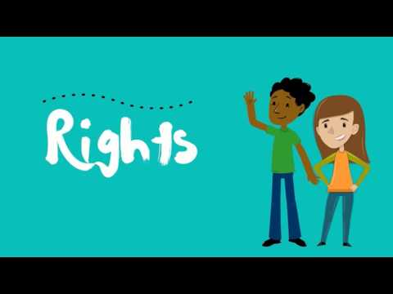
Mental Capacity versus Legal Capacity
Watch this video & Discuss the following:
Has your country ratified the UNCRPD?
How does the law in your country decide when someone does not have the right to make their own decisions?
Are people supported to make their own decisions, or is someone else given the right to make decisions for them?
Are people allowed to make decisions that may be what they want, but not what is best for them?
Who decides how long, or for what a person can’t make decisions independently?

Slide 23
Substitute Decisions
Someone else has the legal right to make decisions for you
These decisions should be in you ‘best interest’, but what does that mean?
What kind of problems might this raise?
Support Decisions
The Committee for the CRPD argues that everyone should be able to make decisions based on their individual will and preferences
Supported decision making - a reasonable adjustment to help people make their own decisions
Q1. What do you think this might look like?
Q2. What concerns might be raised about this?

Slide 24
Resources
Abortion & Disability: The Whispered Conversation
What RJ means to disabled people?
https://www.youtube.com/watch?v=3XMKXmns1Yg
https://www.alliance4choice.com/repeal-58/59/2019/9/abortion-amp-disabilties
Catholics for Choice – https://www.catholicsforchoice.org/resource-library/
https://humanwithuterus.wordpress.com/2013/08/27/hard-questions-about-abortion/
https://www.nwci.ie/images/uploads/15572_NWC_Abortion_Paper_WEB.pdf
https://womenenabled.org/pdfs/Women%20Enabled%20International%20Abortion%20and%20Disability%20-%20Towards%20an%20Intersectional%20Human%20Rights-Based%20Approach%20January%202020.pdf
https://www.spiked-online.com/2020/03/05/abortion-on-the-grounds-of-disability-is-not-discrimination
https://docs.google.com/document/d/1Br7bkF55YOcc6fnEHDxz27pMBDuWEHpwPnIBGLKdVPM/edit?usp=sharing
https://www.facebook.com/Alliance4Choice/videos/1506487046196188/
https://womenenabled.org/pdfs/Women%20Enabled%20International%20Abortion%20and%20Disability%20-%20Towards%20an%20Intersectional%20Human%20Rights-Based%20Approach%20January%202020.pdf
Sara Ahmed, Living a Feminist Life (2017, Duke University Press)
Patricia Hill-Collins and Silma Bilge, Intersectionality (2020, Polity Press)
Crowter & Ors, R (On the Application Of) v Secretary of State for Health And Social Care [2021] EWHC 2536 (Admin) (23 September 2021)
Lucy Jackson, ‘Trauma, tragedy and stigma: The discomforting narrative of reproductive rights in Northern Ireland’ (2020) 35 Emotion, Space and Society pp 3-8
Alison Kafer, Feminist, Queer, Crip (2013, Duke University Press)
P (Sexual Relations and Contraception) v.2 [2018] EWCOP 10 (18 April 2018)

Slide 25
3rd Session
Intersectional stigma:
Abortion, Sex Work, Drug Use and HIV

Slide 26
Multiple Connected Struggle
Cross issues
Cross solutions
Intersecting Oppressors
Intersectionality
Not tokenistic
Voice – Agency & Integrity
Creating inclusivity – not waiting for it

Slide 27
HIV and disabilities are not linked in any way
Le VIH et les handicaps ne sont liés d'aucune façon
El VIH y las discapacidades no están vinculados de ninguna manera
Extremely comfortable!
Extremadamente cómoda
Extrêmement confortable
Very uncomfortable!
Muy incómoda
Très inconfortable
Notes:
Move the dot on the sliding scale

Slide 28
Positive legislation facilitates accessibility of abortion services and mitigates stigma
La legislación positiva facilita la accesibilidad de los servicios de aborto y mitiga el estigma
Une législation positive facilite l'accessibilité des services d'avortement et atténue la stigmatisation
Extremely comfortable!
Extremadamente cómoda
Extrêmement confortable
Very uncomfortable!
Muy incómoda
Très inconfortable

Slide 29
Abortion related stigma negatively affects service providers and the quality of service itself
La stigmatisation liée à l'avortement affecte négativement les prestataires de services et la qualité du service lui-même
El estigma relacionado con el aborto afecta negativamente a los proveedores de servicios y a la calidad del servicio en sí
Extremely comfortable!
Extremadamente cómoda
Extrêmement confortable
Very uncomfortable!
Muy incómoda
Très inconfortable

Slide 30
Do you agree with the following statements? You can add other statements that you wish to discuss with the participants on the blank post-its.
HIV positive people cannot go for abortion especially MA if they are on ART
People who use drugs should not be able to decide for abortion
People who use drugs are not always able to manage medical abortion
All trans men want to avoid pregnancies but also do not want to go for abortion as it is still women related service
Use these “sticker dots” to agree with what someone else has written
Notes:
¿Está de acuerdo con las siguientes afirmaciones?
Êtes-vous d'accord avec les affirmations suivantes?

Slide 31
Working in breakout rooms
1. Identify barriers accessing abortion for sex workers, drug users and people living with HIV (consider your country context)?
2. What can be done by the service providers and government to address the barriers of abortion service for sex workers, drug users and people living with HIV?
3. How can abortion stigma be mitigated for sex workers, drug users and people living with HIV?
Notes:
Medea :
1. Identifier les obstacles à l'accès à l'avortement pour les professionnel(le)s du sexe, les toxicomanes et les personnes vivant avec le VIH (considérez le contexte de votre pays) ?
1. ¿Identifica las barreras de acceso al aborto para las trabajadoras sexuales, los consumidores de drogas y las personas que viven con el VIH (considere el contexto de su país)?
2. Esma
2. ¿Qué pueden hacer los proveedores de servicios y el gobierno para abordar las barreras del servicio de aborto para las trabajadoras sexuales, los consumidores de drogas y las personas que viven con el VIH?
2.Que peuvent faire les prestataires de services et le gouvernement pour surmonter les obstacles aux services d'avortement pour les professionnel(le)s du sexe, les toxicomanes et les personnes vivant avec le VIH ?
3. Gvantsa
3. Comment atténuer la stigmatisation de l'avortement pour les professionnel(le)s du sexe, les toxicomanes et les personnes vivant avec le VIH ?
3. ¿Cómo se puede mitigar el estigma del aborto para los profesionales del sexo, los consumidores de drogas y las personas que viven con el VIH?

Slide 32
After today’s workshop, which image resonates how you feel about information shared throughout the session?
Image Description: A grassy field with some trees overlooking a clear blue peaceful ocean. The sky has a few clouds.
Image Description: A field with tall yellow grass. The sky shows a rainbow over dark clouds.
Image Description: Different stages of sprouting plants emerging from soil.
Image Description: Dark clouds and lighting striking at multiple parts of the sky.
Image Description: Blue ocean water curling into a wave.
Notes:
Después del taller de hoy, ¿qué imagen resuena cómo se siente acerca de la información compartida durante la sesión?
Après l'atelier d'aujourd'hui, quelle image résonne ce que vous pensez des informations partagées tout au long de la session ?

