Slide 1
Accompanying Abortions:
Busting Stigma in Practice
Workbook
Part I
What is medical abortion, abortion stigma and accompaniment?
What are our values, challenges and needs around accompaniment in our globally diverse contexts?
How does abortion stigma at various levels affect our work as abortion companions and providers?

Slide 2
About this workbook
This workbook comes from the online inroads Global Abortion Accompaniment workshop.
Based on the slide deck of the 5 sessions, we prepared a workbook version to facilitate the learning experience of all inroads members, including those that were not able to attend the live session.
Each session of the workshop focused on building co-created spaces of learning between member facilitators and participants. As such, a participatory approach is embedded within the workshop materials, in order to encourage active learning and a diversity of responses.
We invite you to use this material to facilitate learning spaces within your community.

Slide 3
Las Acompañantes
Session 1 : Daniela TV (Di RAMONA) & Sandra Cardona + Vanessa Jimenez (Necesito Abortar)
México

Slide 4
What is stigma and abortion stigma?
A set of negative and often unfair beliefs that a society or group of people have about something.
Stigma

Slide 5
Abortion
stigma
Negative attitudes and beliefs about abortion may act as barriers to accessing safe services and can make it difficult for people to talk about their experiences of abortion. This can be very isolating, and may force people to continue unwanted pregnancies or to seek unsafe abortion.

Slide 6
What are mifepristone and misoprostol?
Mifepristone
It blocks the action of progesterone (a hormone necessary to maintain a pregnancy), alters the endometrium, softens the cervix and causes contractions.
Misoprostol
Prostaglandin (not hormone) that causes cramping and bleeding to make the uterus empty.
Are they reliable?
Multiple controlled clinical trials have shown the combination of mifepristone and misoprostol to be an effective medical abortion regimen, with efficacy rates ranging from 95% to 98%.

Slide 7
This how we met the misoprostol…
BRAZIL: https://womenhelp.org/en/page/1182/the-amazing-story-of-misoprostol

Slide 8
Gossip and facts about medical abortion

Slide 9
What are common myths and gossip about medical abortions in your context?
.
That medical abortions cause infertility
Use these “sticker dots” to agree with what someone else has written

Slide 10
Common gossip
Facts
It's the most recommended process in early stages because it is non-invasive.
Effectiveness ranges from 95% -98%.
Self-managed abortion!
Effectiveness has nothing to do with the number of uses.
It is used for advanced abortions with a high level of effectiveness.
Girls, teens, women and other pregnant people can use it safely.
The doses do not have to do with the complexion but with the weeks of gestation.
More risks than a surgical procedure
It doesn’t work
It only works in the first 9 weeks of pregnancy.
Only can be administered by medical personnel
Only adults can use it.
If you use it more than once, it stops working
Doses vary by weight, height, and age of the user.

Slide 11
Accompaniment:
A tool against
abortion stigma
Beyond legal abortion, accompanied abortion!

Slide 12
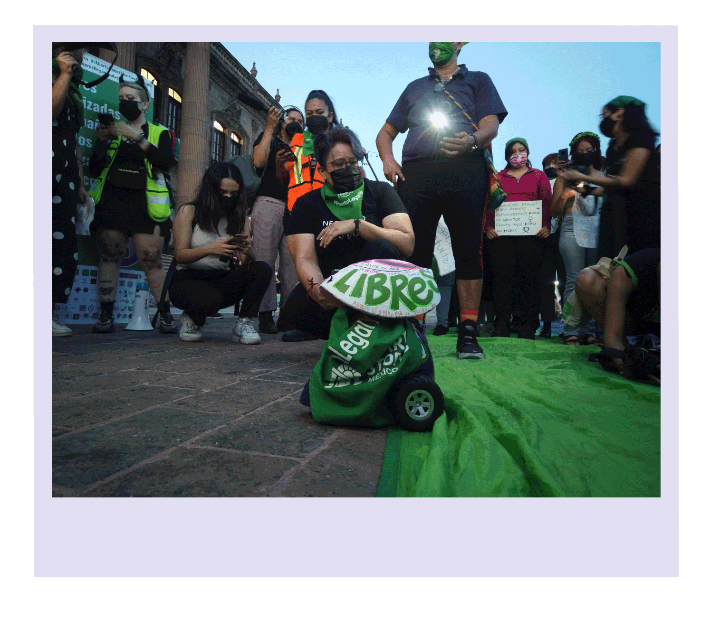
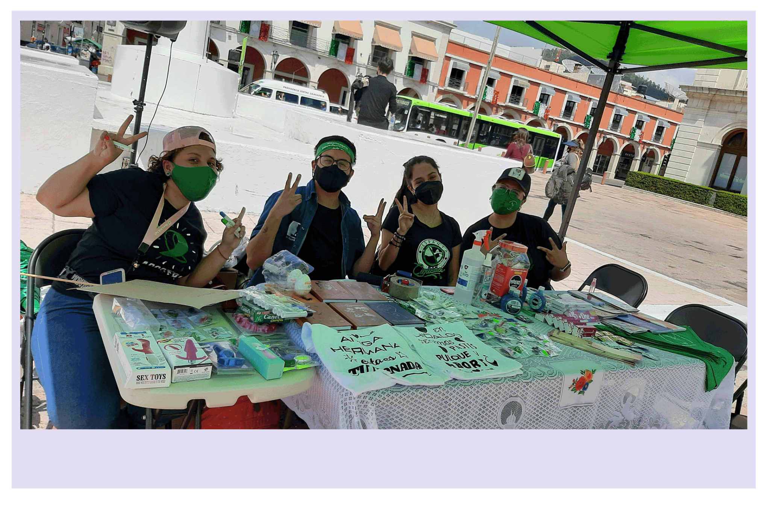
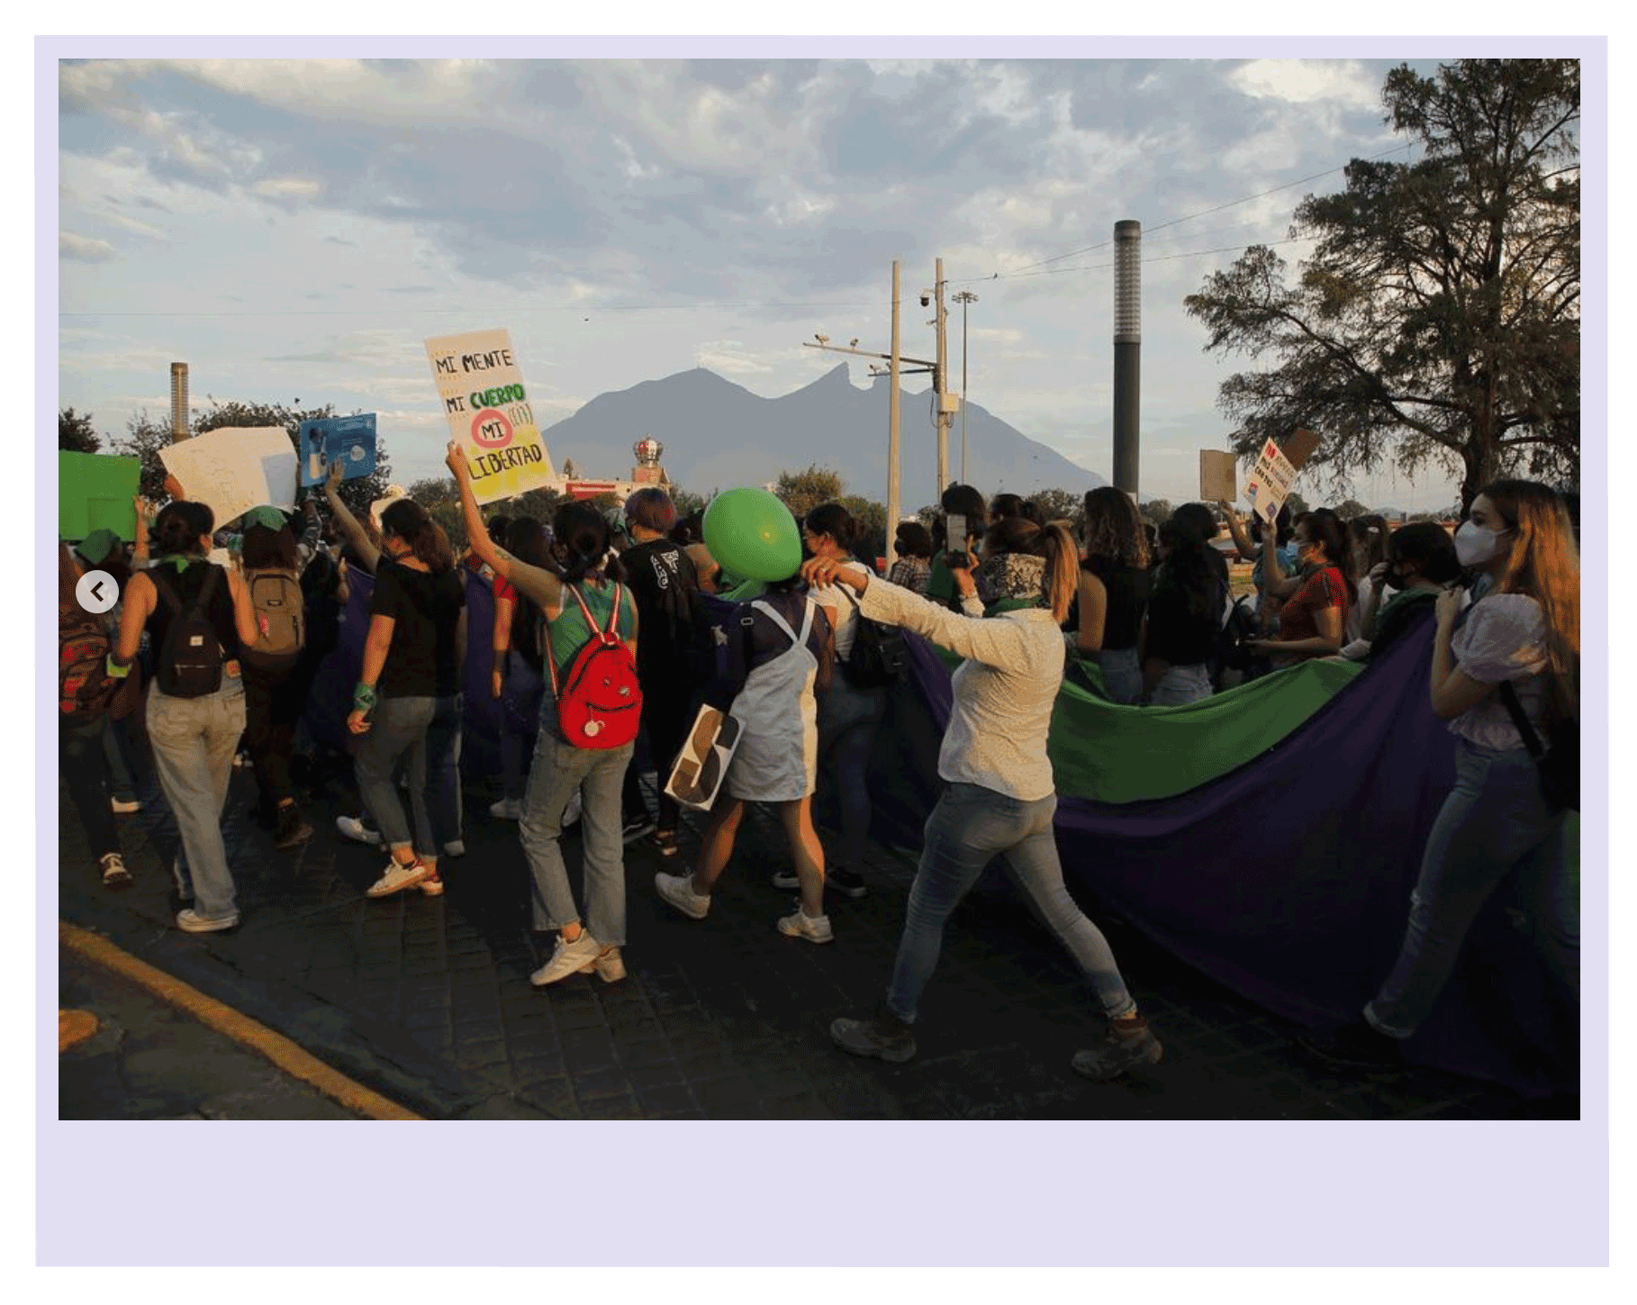
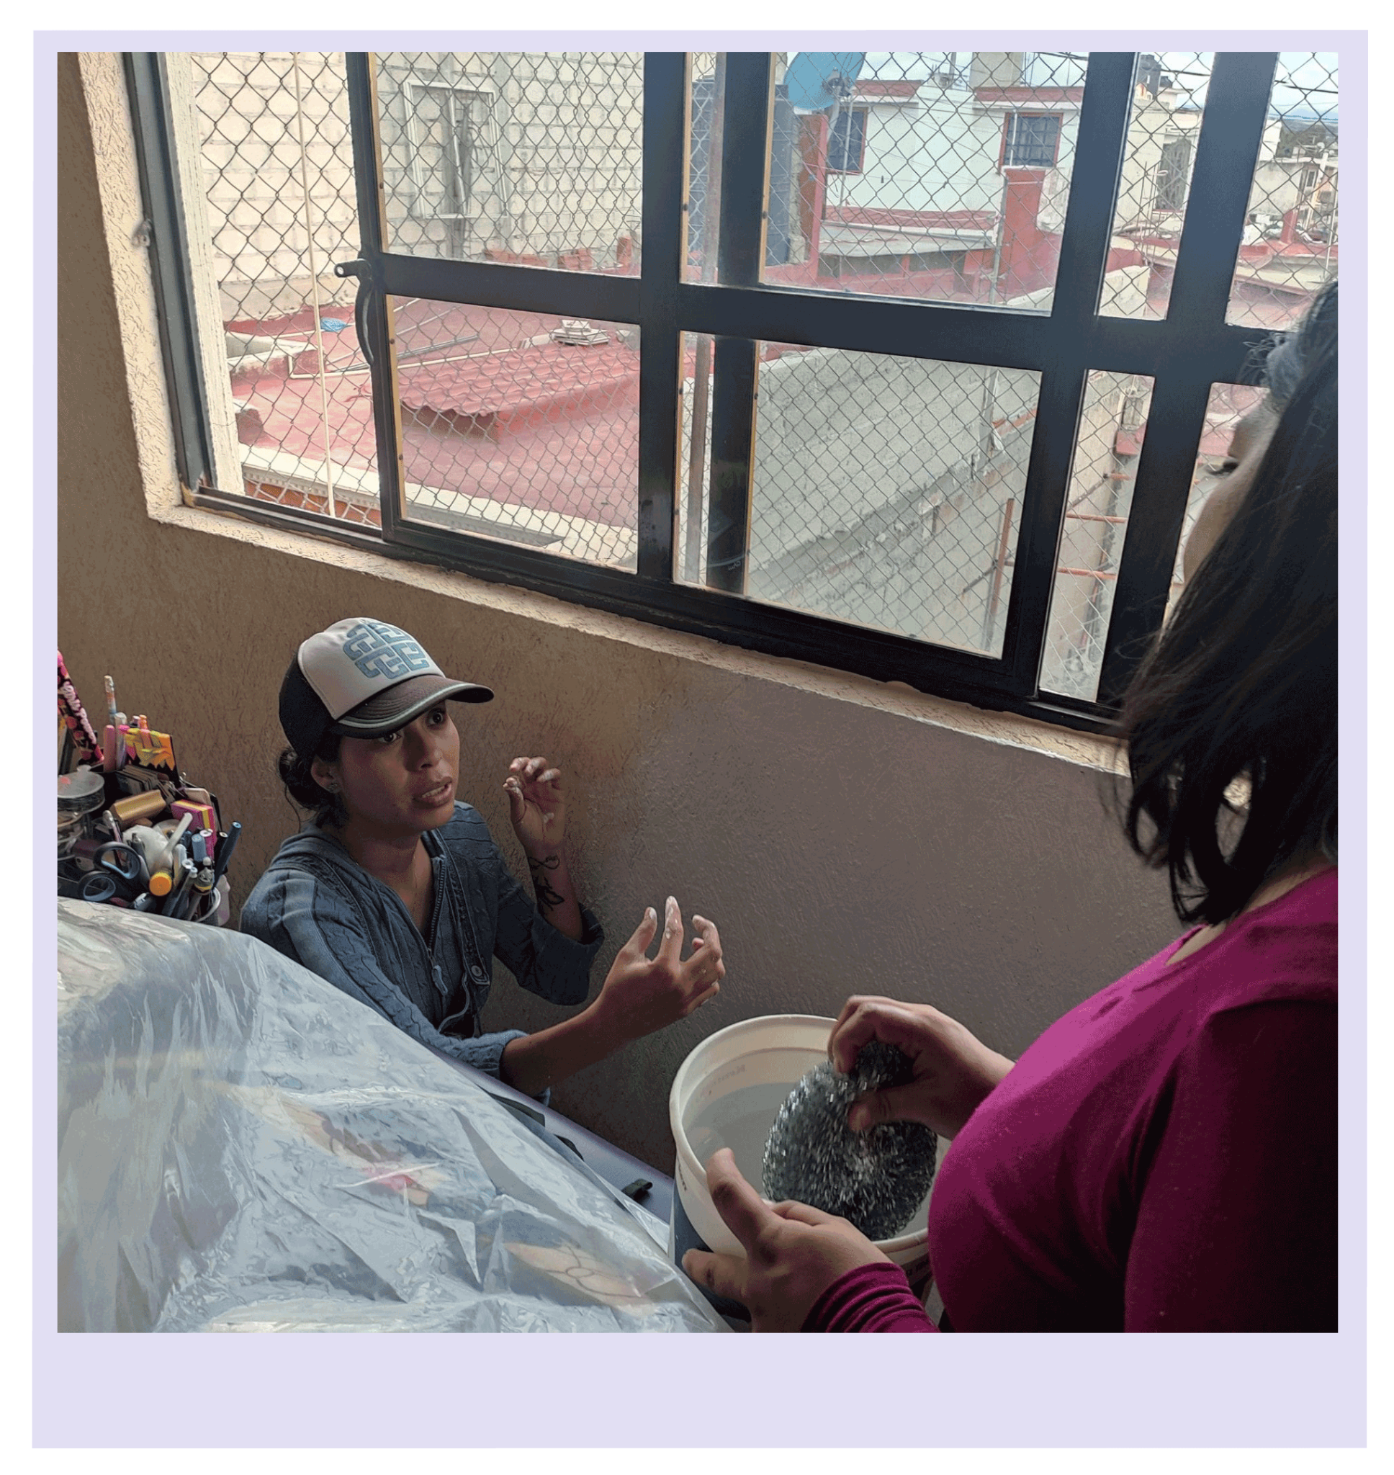
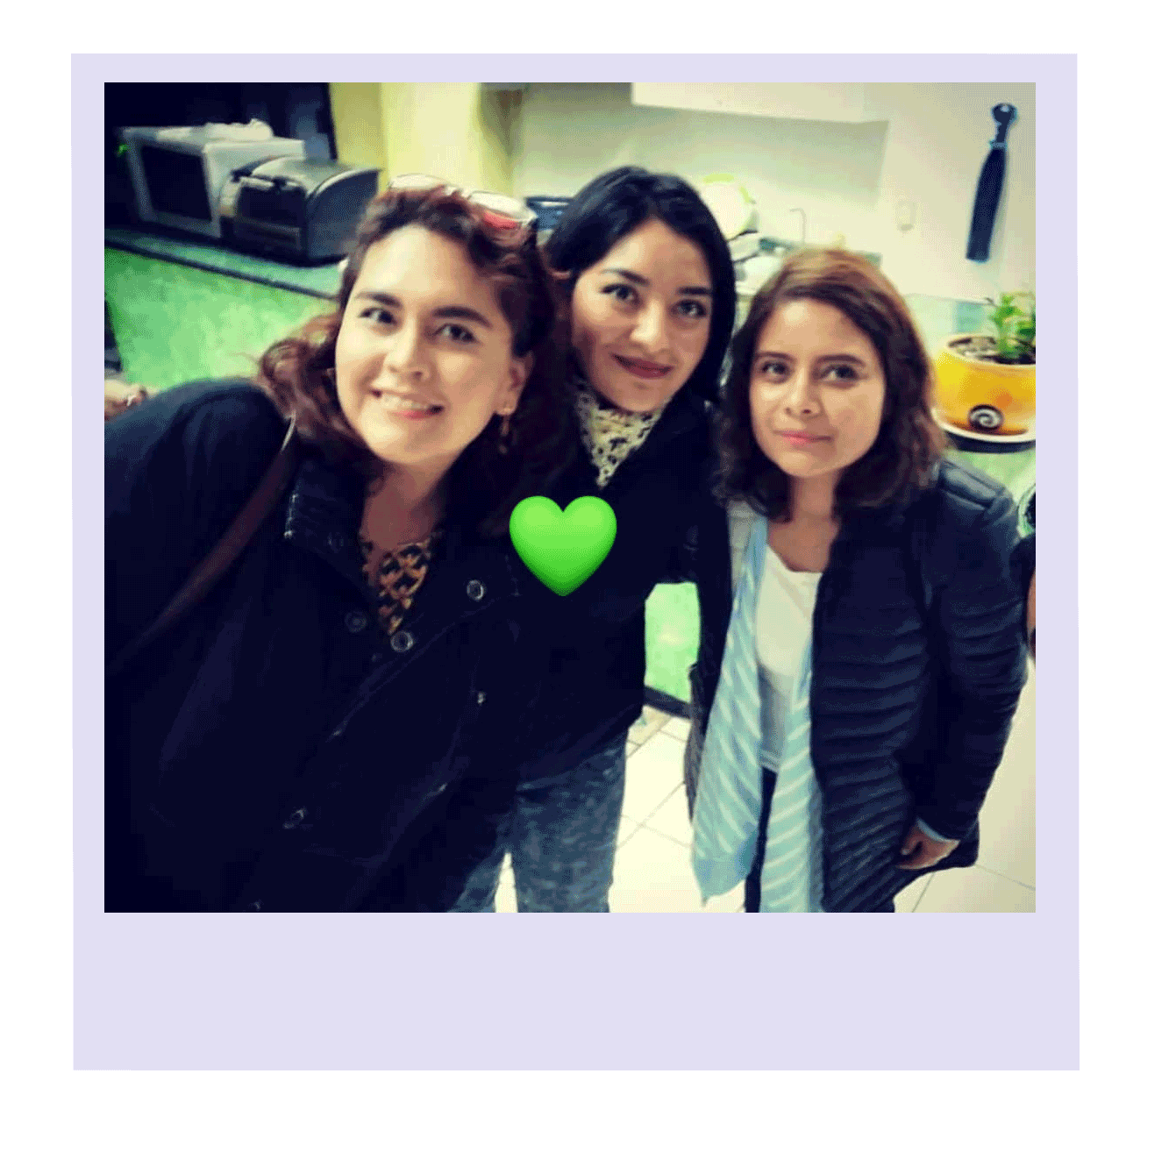
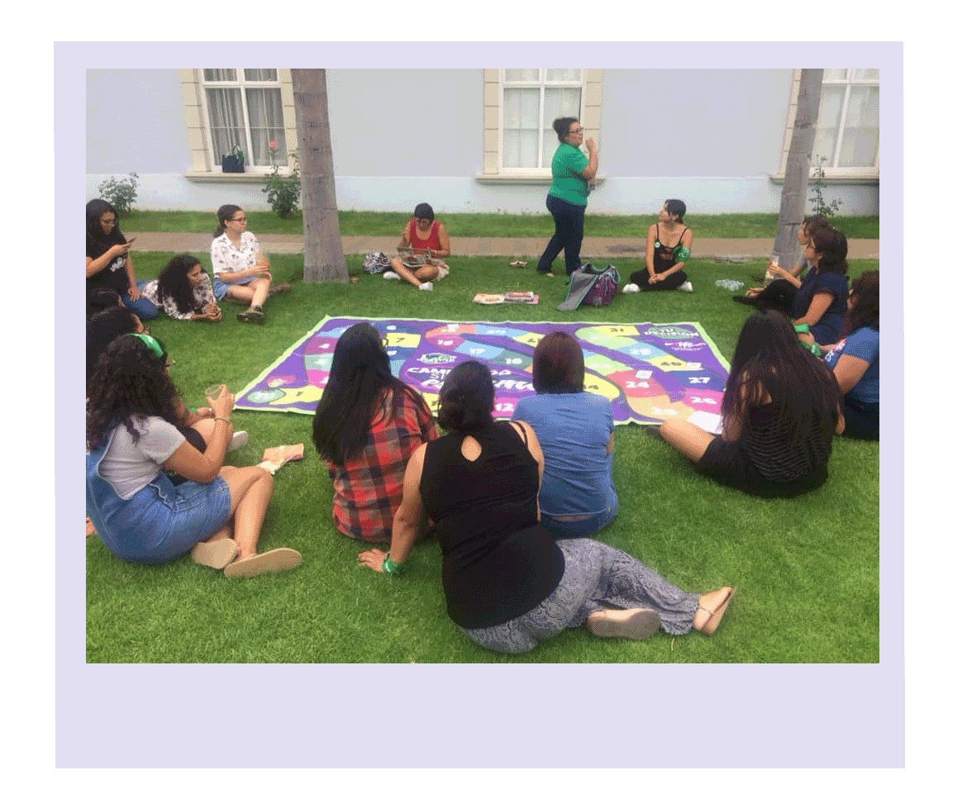
What we do and what we don’t do
Photo: Instagram @kayalabruja
Photo: Instagram @velia_delacruz

Slide 13
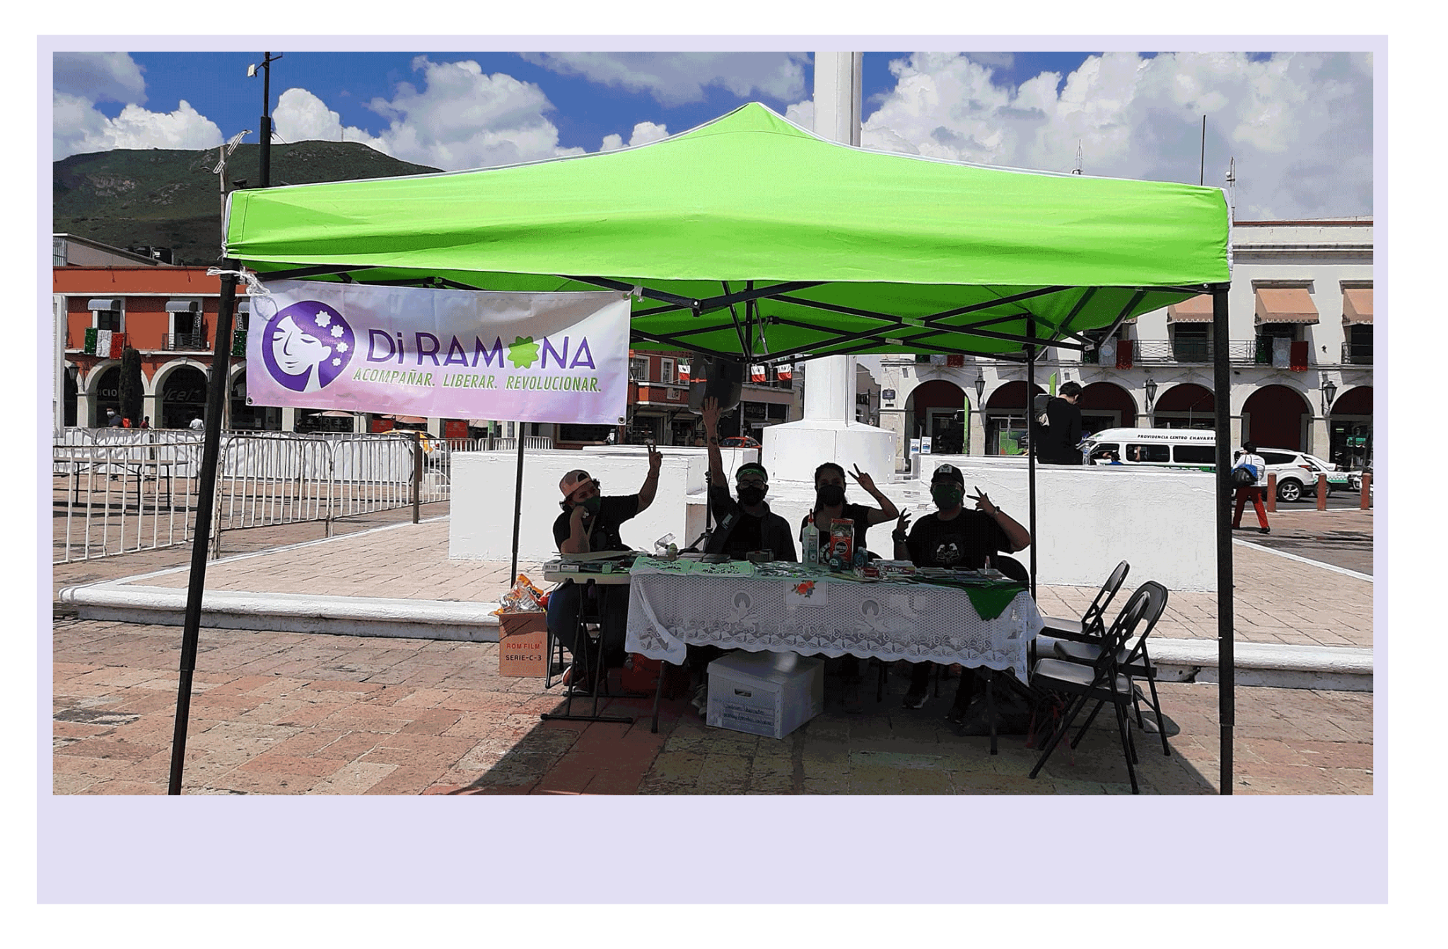
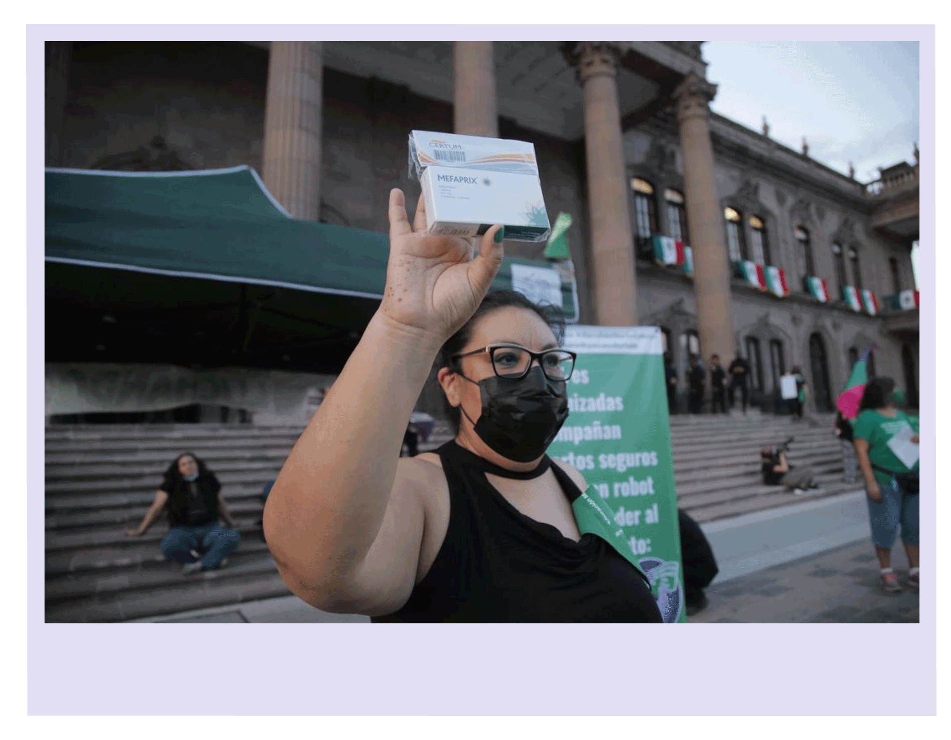
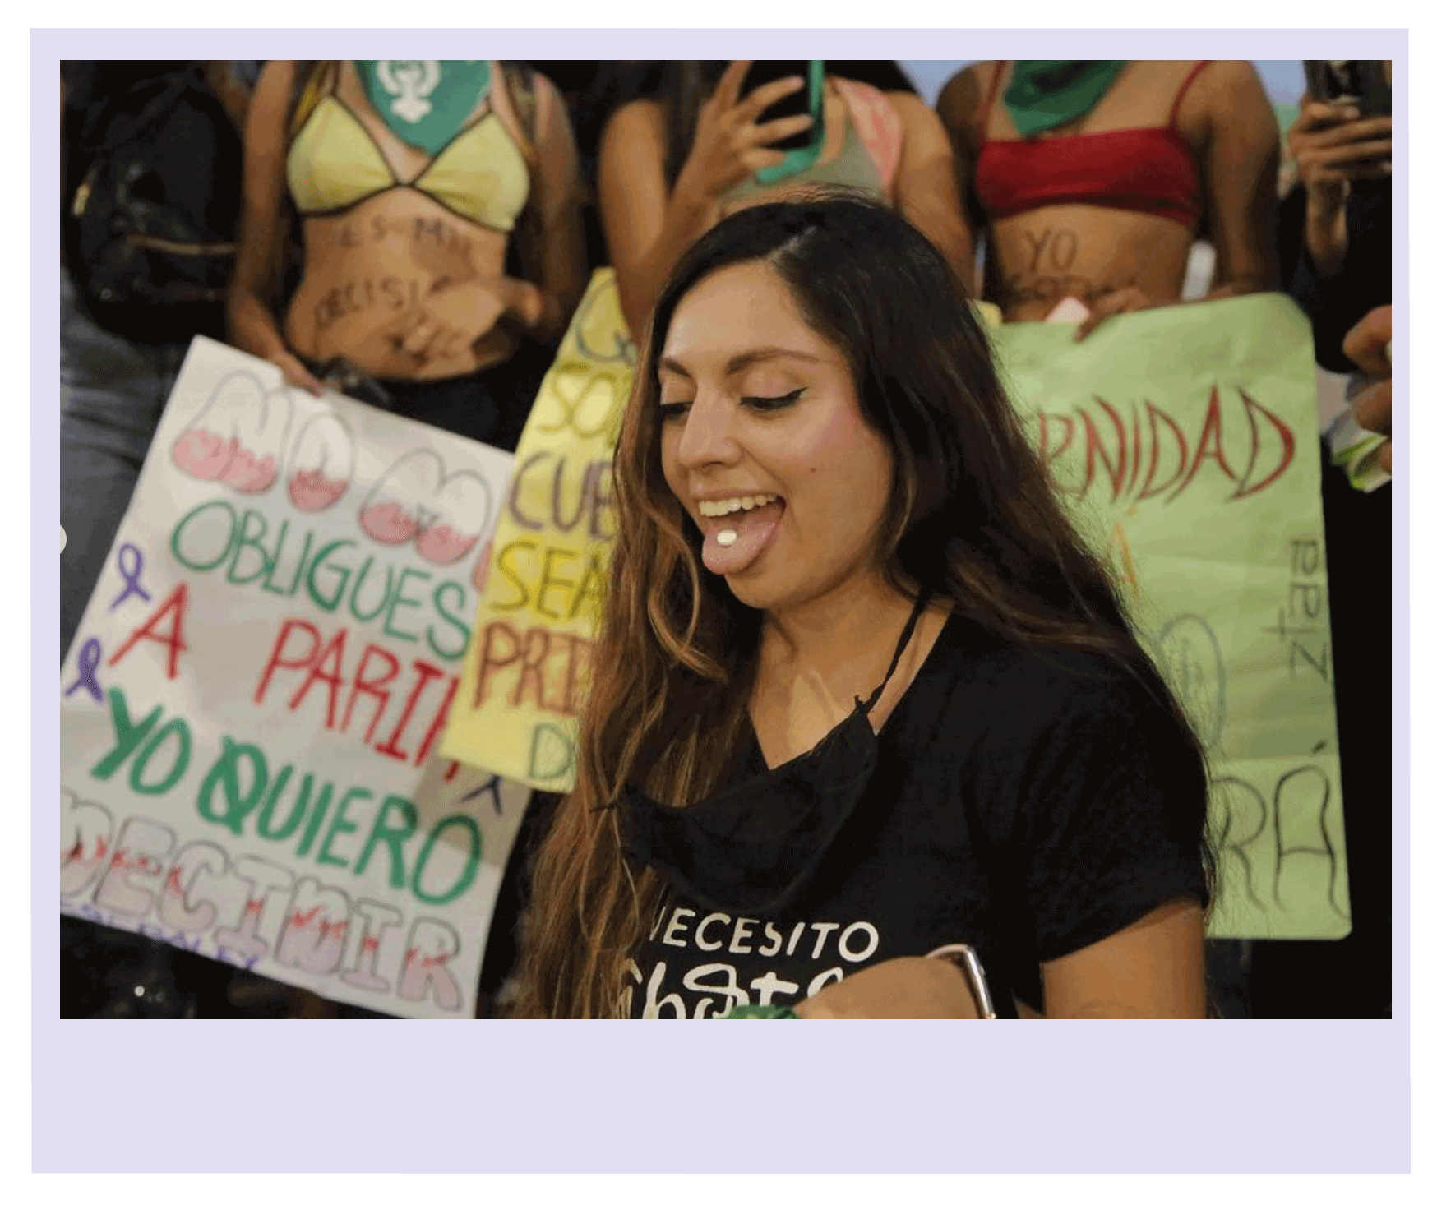
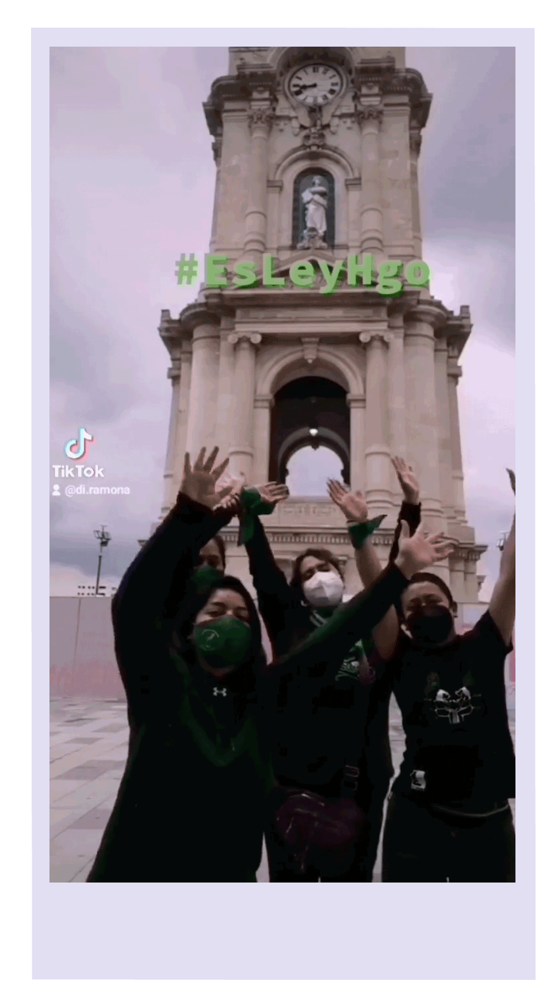
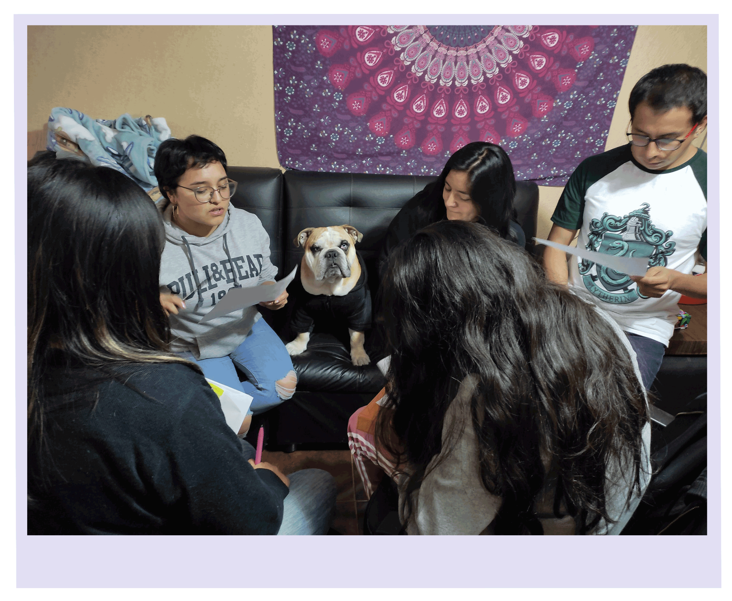
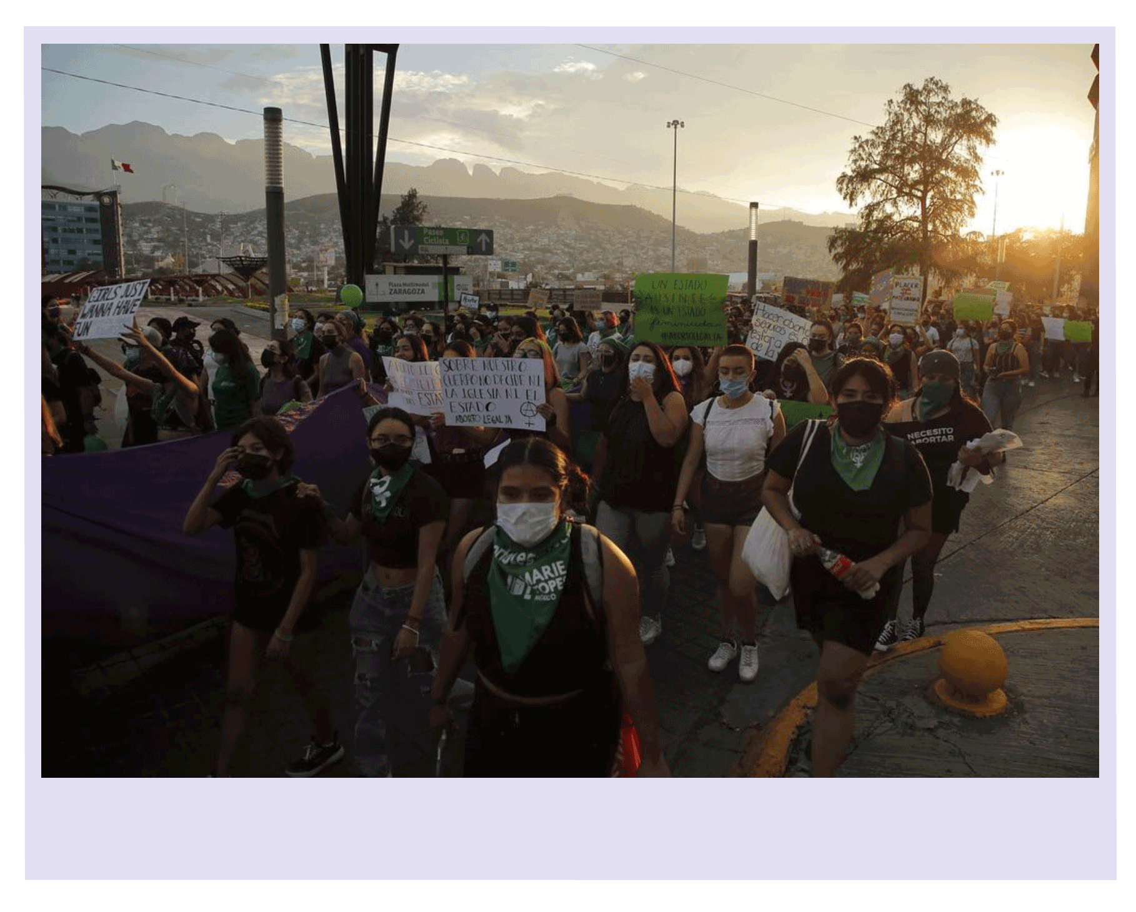
Why does it contributes to abortion stigma busting?
Photo: Instagram @velia_delacruz
Photo: Instagram @velia_delacruz
Photo: Instagram @velia_delacruz

Slide 14
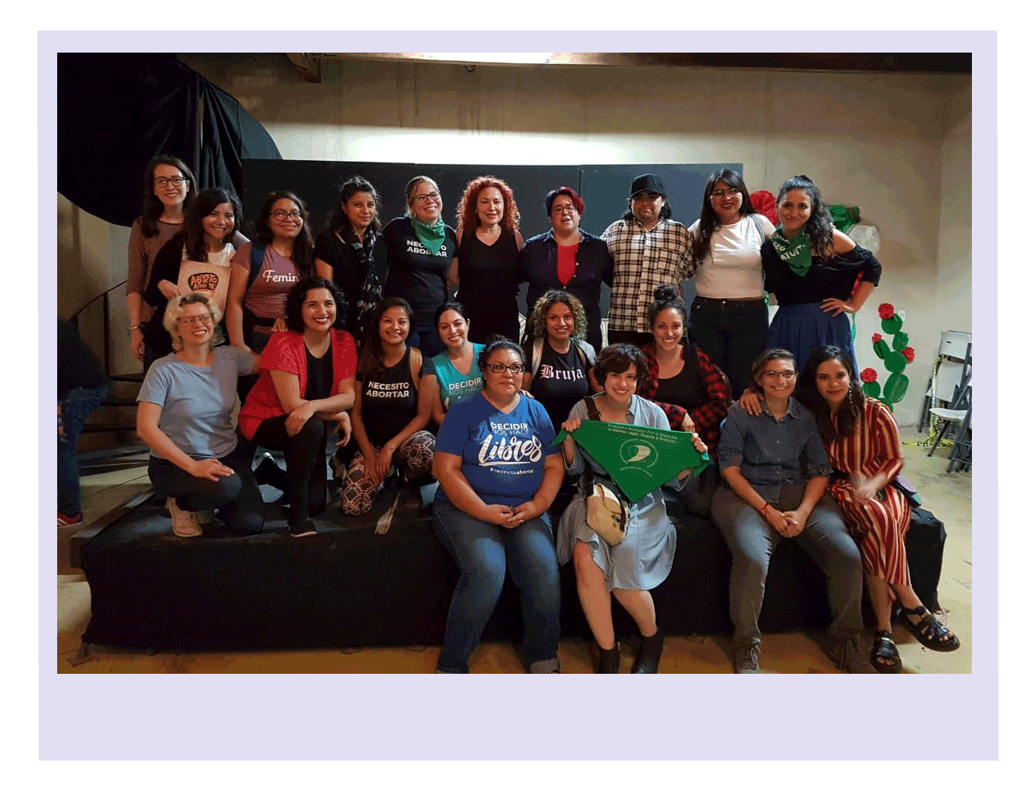
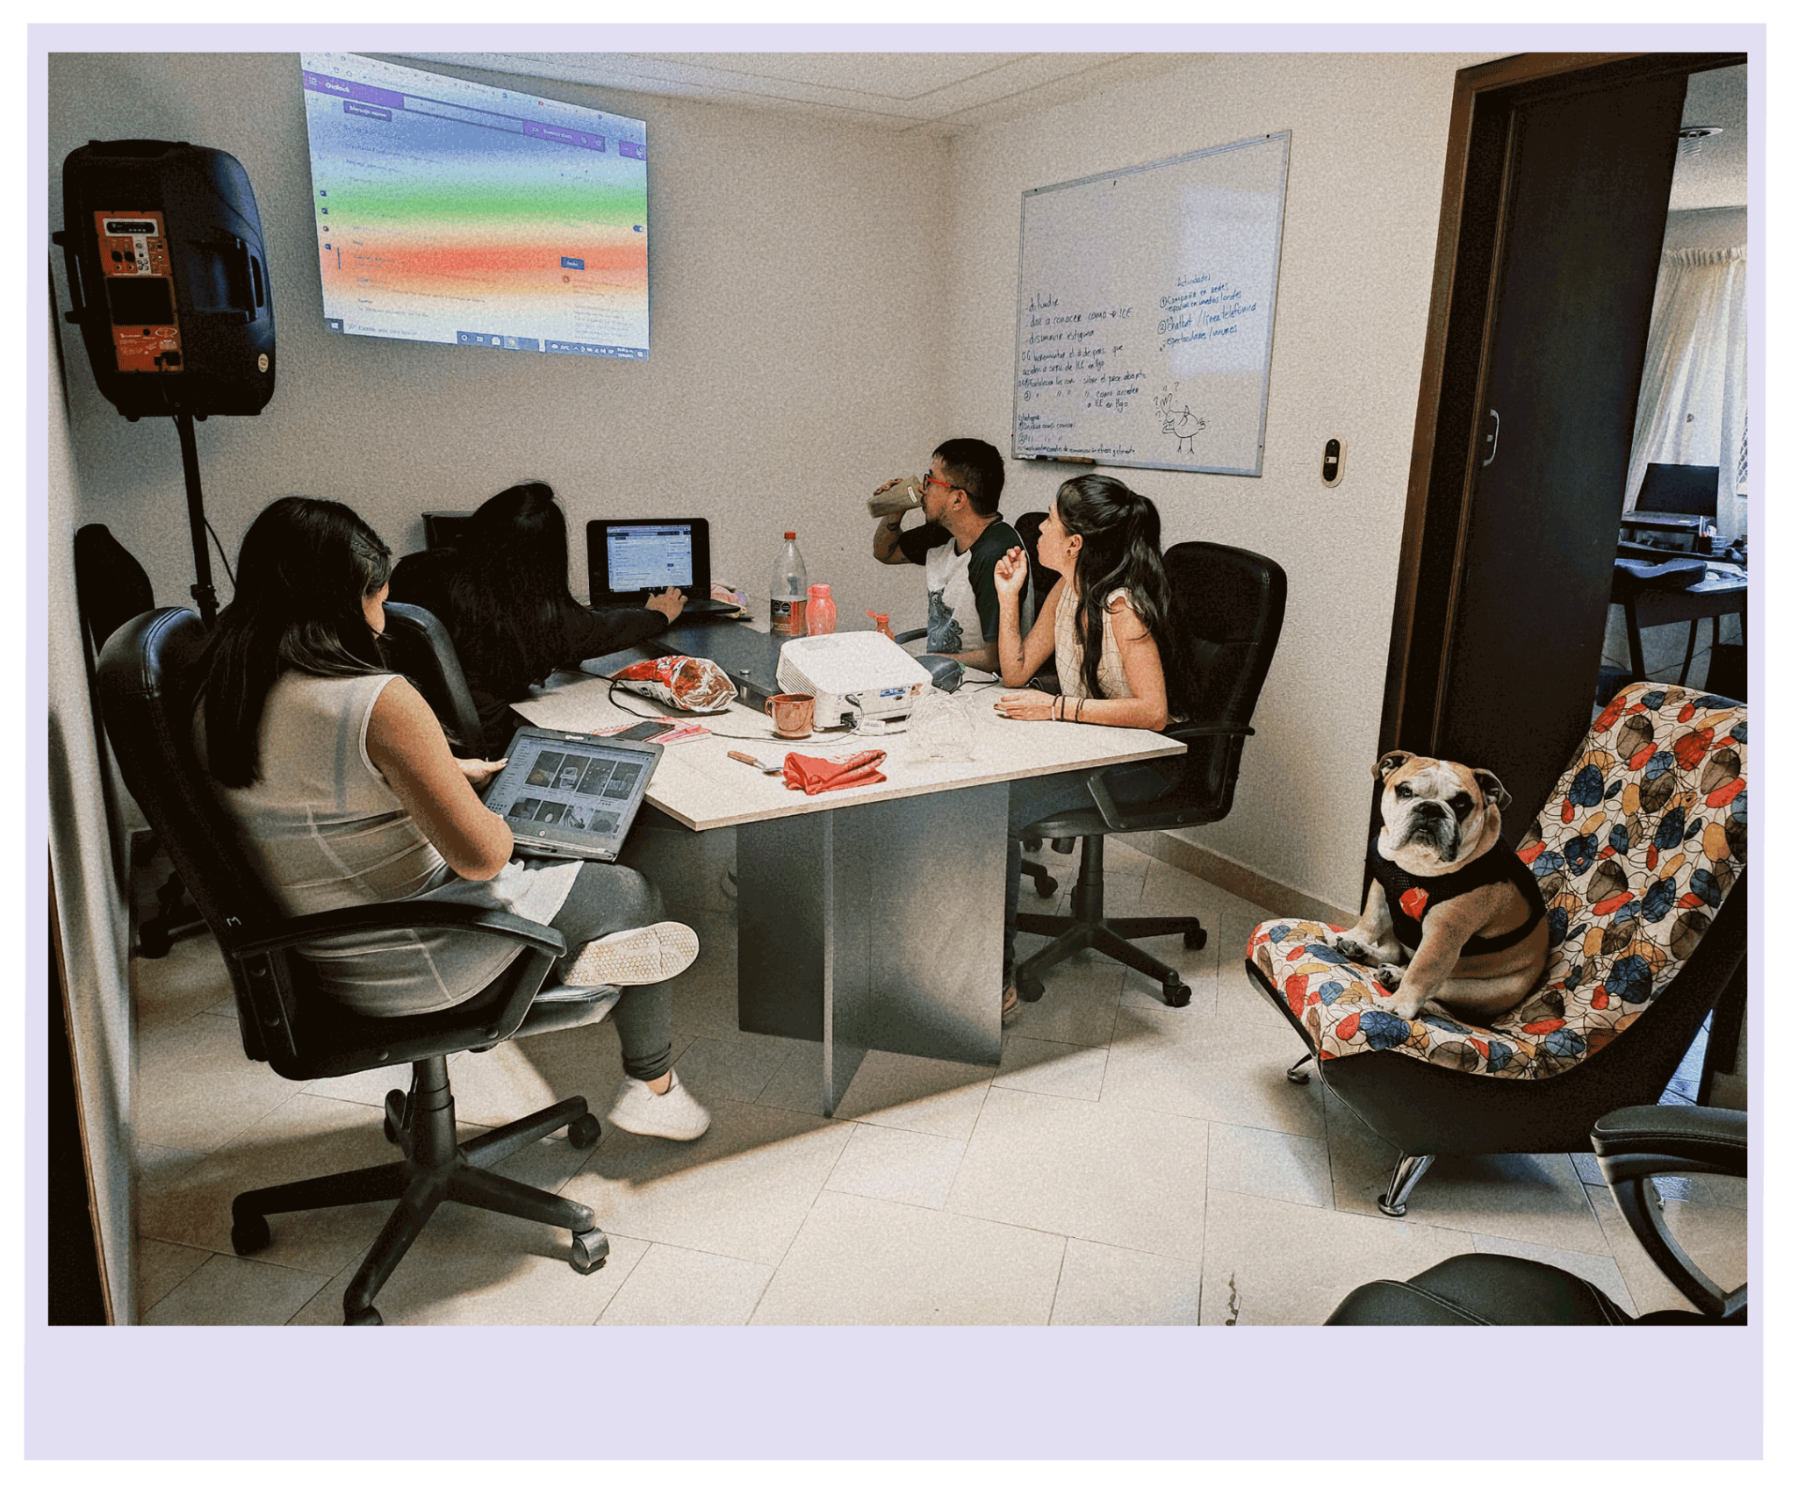
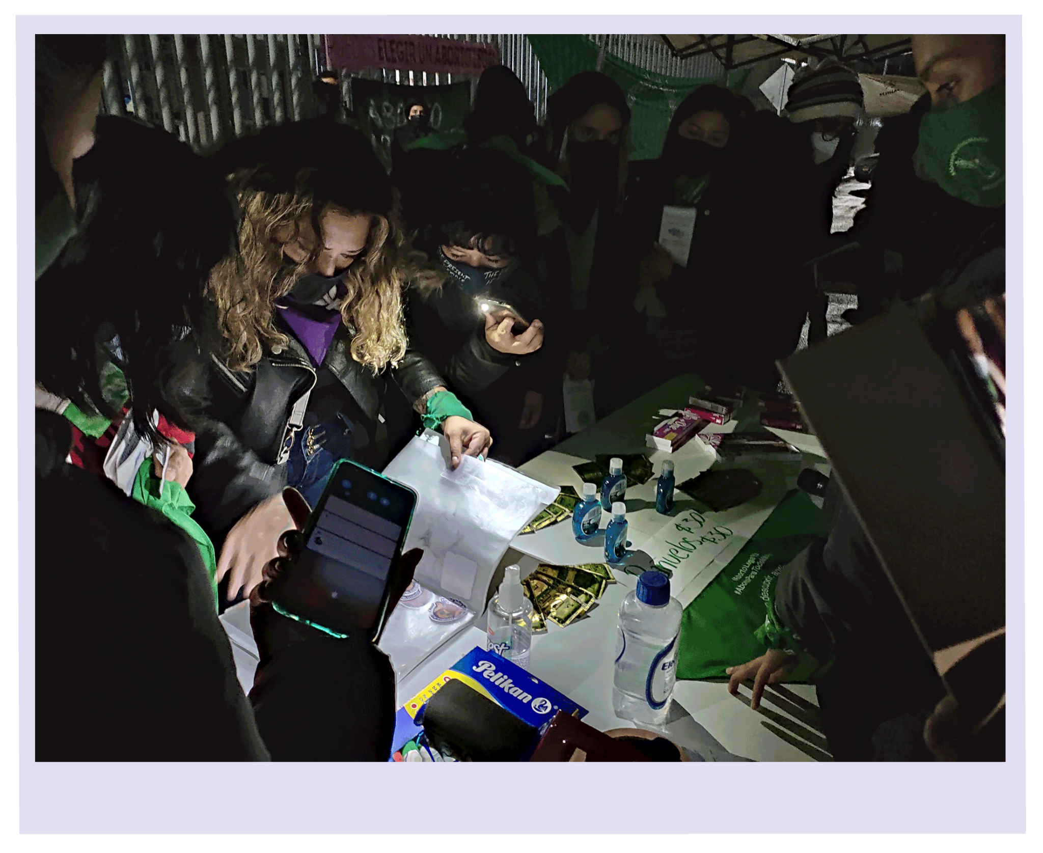
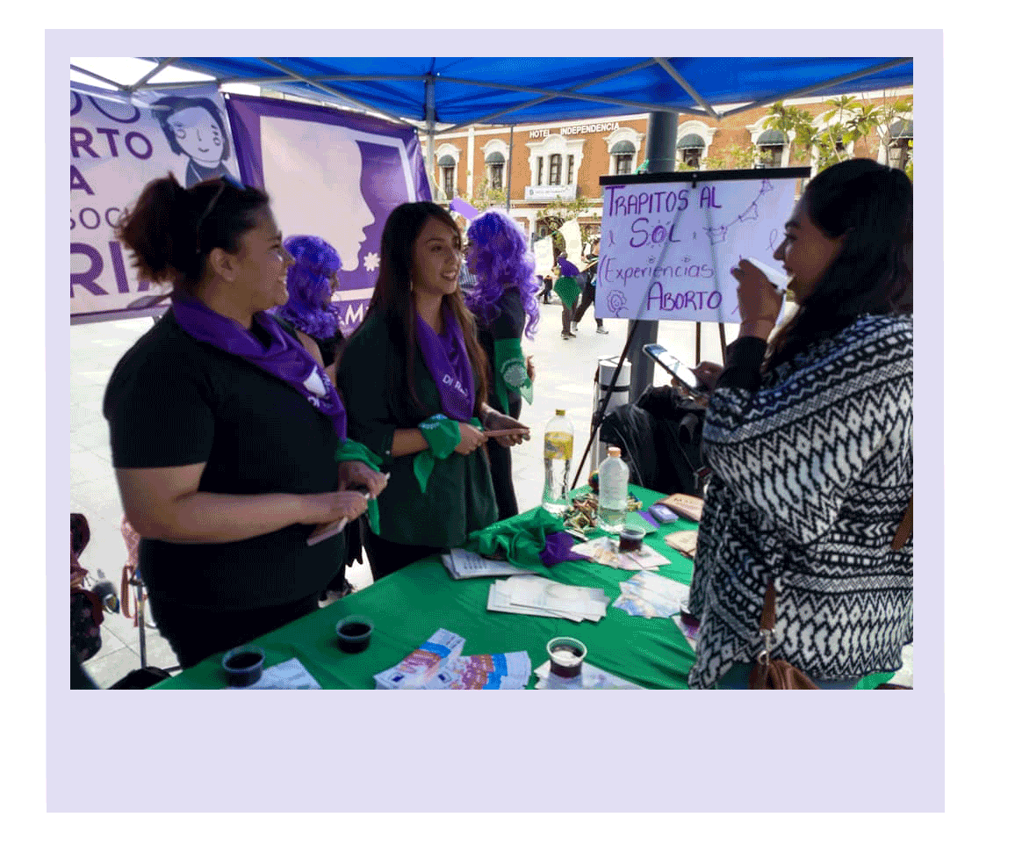
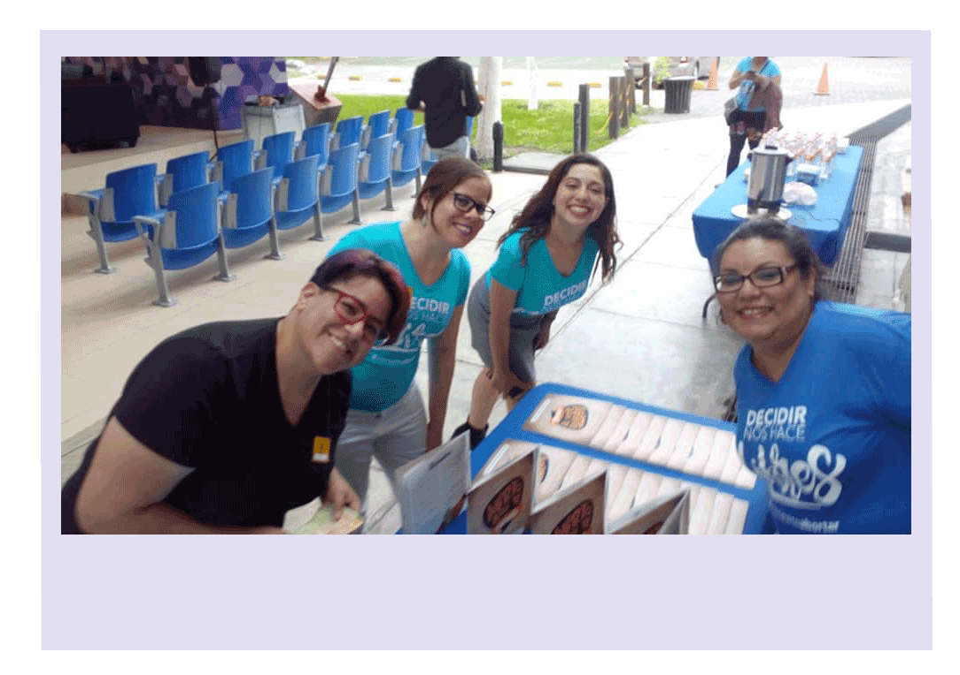
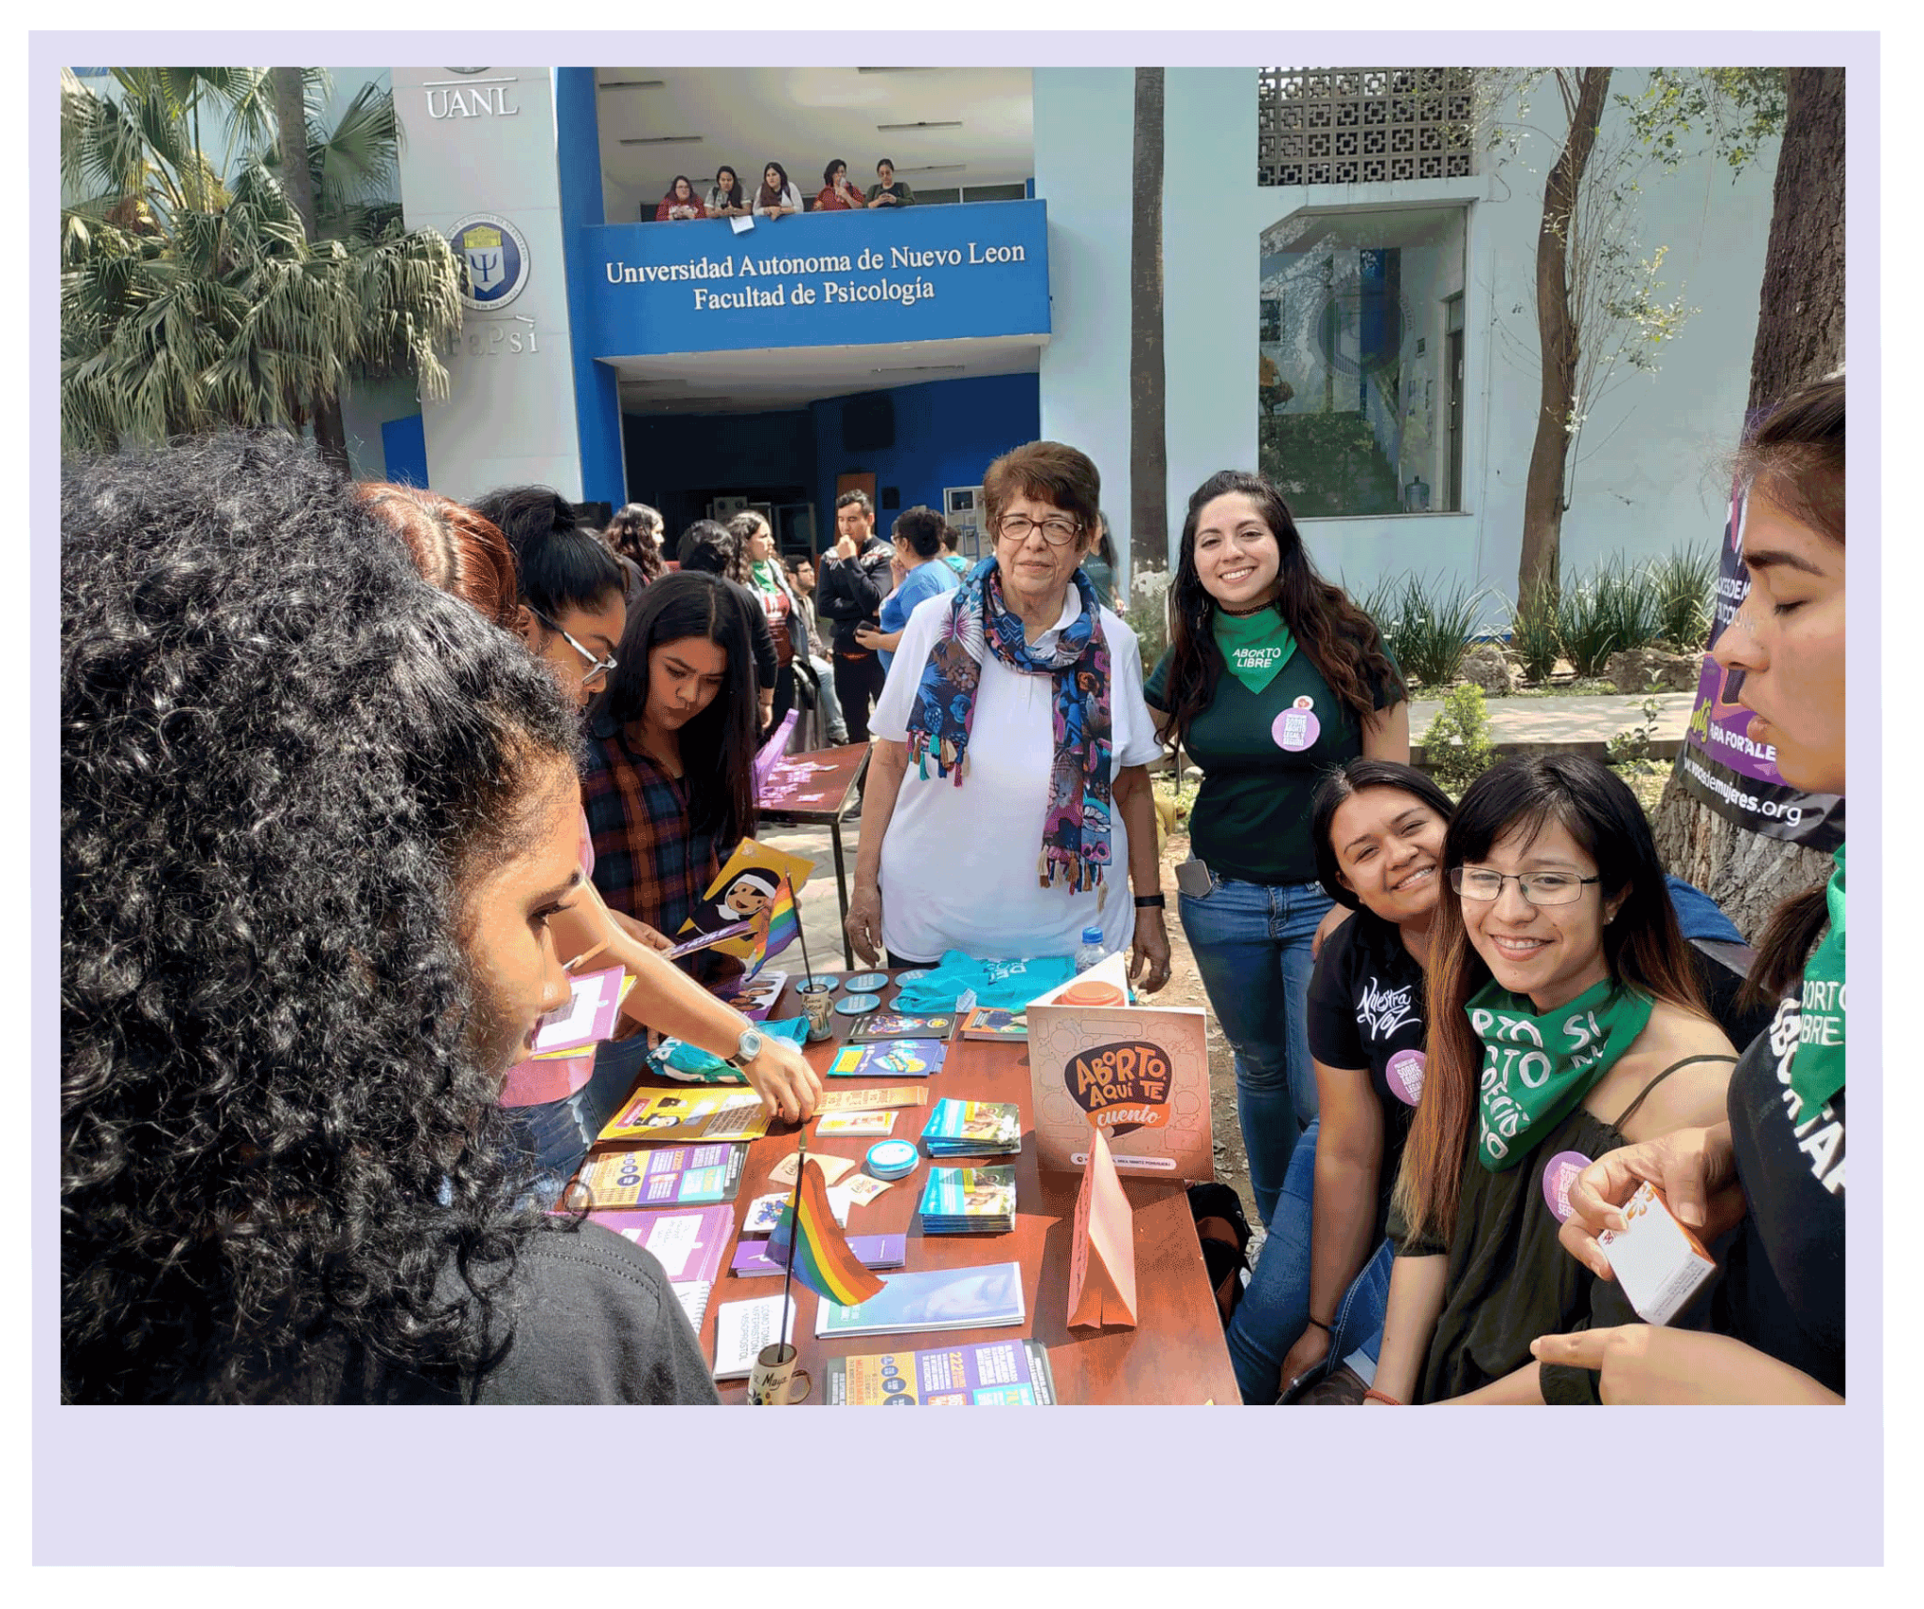
Care networks between acompañantes

Slide 15
Accompaniment is...
.
That medical abortions cause infertility
Use these “sticker dots” to agree with what someone else has written

Slide 16
A World with Accompaniment, Feminist Companionship,
and Referral in Diverse Setting
Session 2: by Mitra Kadarsih (midwife) and Ika Ayu (Samsara), Indonesia

Slide 17
PARTICIPANT INTRODUCTION
Participant will be asked to mention 1 word that shows their hope which has the same letter with their preferred name in this session
Participant will be asked to share their experience on accompanying people who perform abortions/hear a story/witnessing - each of them for 1 minutes
Hi, great to be here. I’m Ika, i hope in this session I can get an INSPIRATION.
I never had an experience on accompanying abortion but I produce many campaigns to tackle abortion stigma, but I once know that my Mom ever had an abortion.

Slide 18
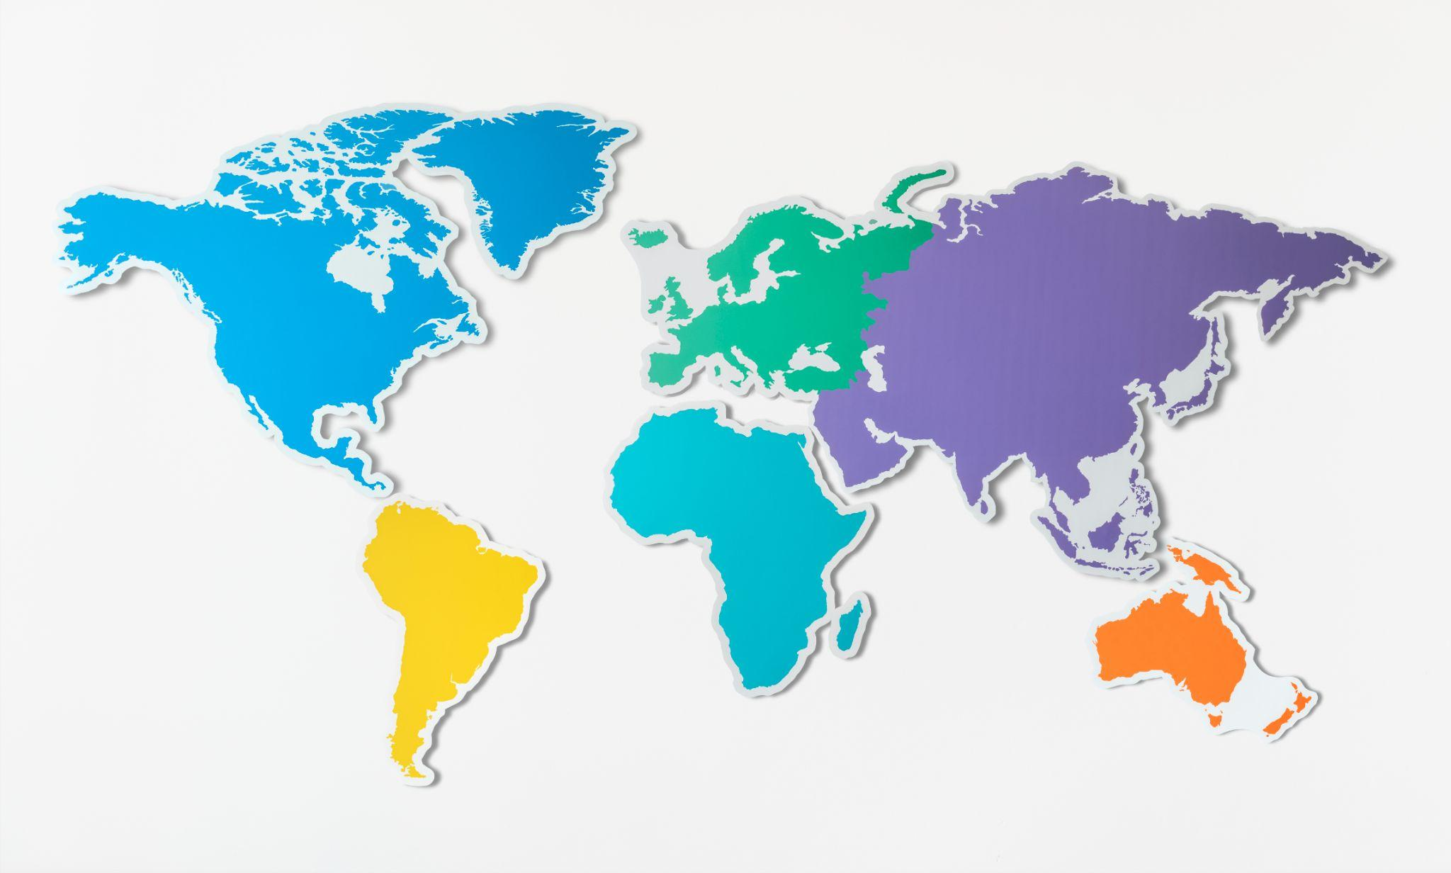
What does abortion companionship look like in your place?
https://padlet.com/ikaayukristia/ol3xvln3918l2ljz

Slide 19
Create a collage of images that represent feminist based companionship
https://s.id/FeministCompanion1
Put a picture that represent feminist-based companionship in your own opinion
Explain about the picture - what story, what value that lies behind the picture and how it relate to the feminist-based companionship
List out our challenges, strengths and security needs
https://s.id/visionboardcometrue

Slide 20
An Abortion Companionship Vision
Board
VALUES
Accessible
Freedom
hotline,
web based access
Clinic,
Hospitals’
home, on the boat (crossborder)
trust women (people) strength
Networking
acompanying abortions can be anywhere
Access to Mife-Miso
Shelter
Safe space
CONTEXTS
Choice
Psychosocial support
TBA, Midwives, Doctors
Pharmacies
Inclusive
Confidential
Non Stigma

Slide 21
Abortion stigma
and its role in our abortion work
Session 3: Natalia Broniarczyk, Karolina Więckiewicz
(Abortion Dream Team), Poland
Notes:
NAT
Tu się przedstawiamy - 5 minut
ADT, AWB,
We are going to talk about abortion providers but we know that there are different AP - doctors, midwives, doulas, scompaniantes, abortion friends, groups, individuals etc.

Slide 22
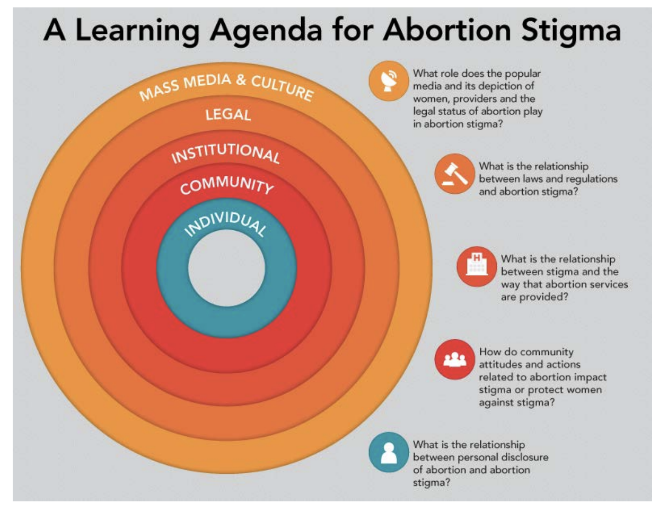
What are the representations of stigma on each level that in your view can have an impact on your own stigma and your work as abortion providers?
Notes:
https://jamboard.google.com/d/1Ieau5q0VZp4FyDEa0Z-5exlJd9GJLeG-gYm1pWDTc8k/viewer?f=1

Slide 23
What role does the popular media and its depiction of those who need and have abortions, abortion providers and the legal status of abortion play in abortion stigma ?
Mass media and culture
.
Use these “sticker dots” to agree with what someone else has written

Slide 24
What is the relationship between laws and regulations and abortion stigma?
Legal
.
Use these “sticker dots” to agree with what someone else has written

Slide 25
What is the relationship between the way abortion (services) is provided and abortion stigma?
Institutional
.
Use these “sticker dots” to agree with what someone else has written

Slide 26
How do community attitudes and actions related to abortion impact stigma or protect those who need/have abortions from stigma?
?
Community
.
Use these “sticker dots” to agree with what someone else has written

Slide 27
What os the relationship between personal disclosure of abortion and abortion stigma?
Individual
.
Use these “sticker dots” to agree with what someone else has written

Slide 28
How is this important in the providers’ work?
All our work is affected by stigma on each level
We ourselves are all affected by stigma
Auto-stigma, self-stigma, own-stigma
We all have it
Our own stigma affects the way we work on abortion and people we support
It is important to realize how it happens
It has an impact on ourselves and we can overcome this so that our work is not a burden
Notes:
KARO
7

Slide 29
How can abortion stigma affect our role as abortion providers?
Us and Our Role / People and their needs
thinking that we can SAVE people
Assumptions about people we are supporting
Rescuing, healing people
Solving all their problems
No boundaries, no limits
Feeling you are the best person that can happen to a person and proving that
Abortion of „their” dreams (choice)
Apologizing for things that are not depending on us
Assuring people that everything will be ok, protecting people from things we are afraid of cause of our own stigma (no pain, no necessity to go to the hospital etc.), coloring reality instead of admitting it can be different, not being sincere out of fear
Pretending we know everything
Making people dependent on us
Taking responsibility of giving the „best” possible abortion experience
Lying to people about what they should „prepare” to see, feel etc.
Intersectional stigma

Slide 30
Radical empathy is not about understanding everyone and compassion with everyone
DESTIGMATIZATION IS A PROCESS, NOT A GOAL
Notes:
2

Slide 31
Contact us:
Di RAMONA
FB: diramona.hgo
IG: diramona.hgo
Necesito Abortar
FB: necesitoabortar
IG: necesitoabortar
necesitoabortar.mx
Samsara
hello@samsara.or.id
IG: perkumpulan.samsara
Abortion Dream Team: kontakt@aborcyjnydreamteam.pl

